Slide 1

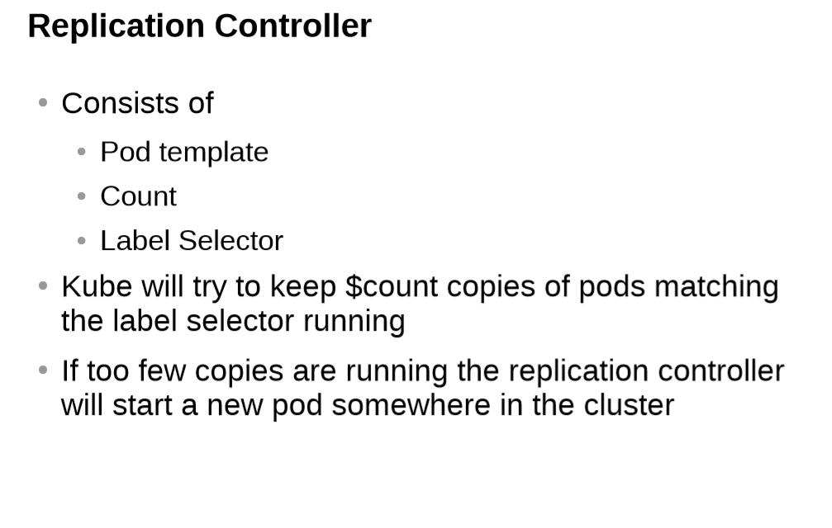

Slide 2
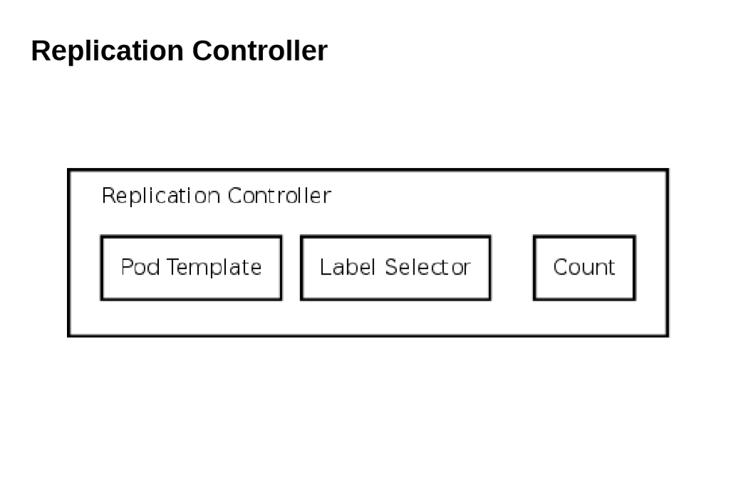

Slide 3
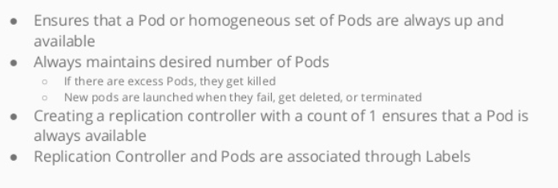
Replication Controller

Slide 4
Replica Set
Replica set is the next-get Replication Controller
It support a new selector that can do the selection based on filtering according a set of values
Example: Environnent Ethier "Dev" or "QA«
not only based on equality, like replication controller
e.g "Environment" == "Dev“
This Replica Set, rather than the replication controller, is used by the Deployment Object

Slide 5
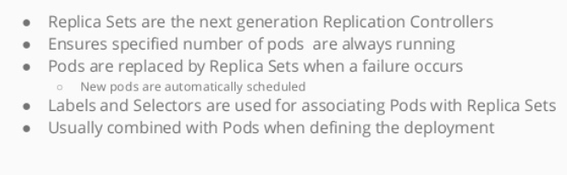
Replica Set

Slide 6
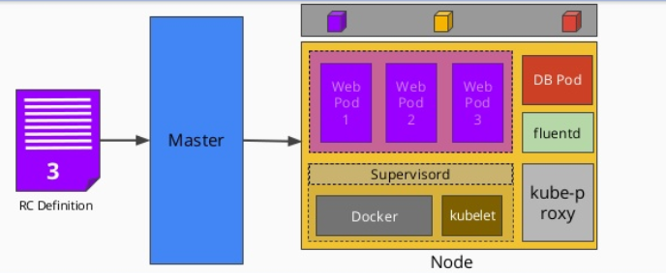
Scaling Pods with Replication Controller

Slide 7
Demo
Scaling Pods with Replication Controller

Slide 8


